Slide 1
Overview of Linux

Slide 2

What is Linux?
A widely used Open Source Unix-like operating system.
Linux was first released by its inventor Linus Torvalds in 1991.
The inner workings of Linux are open and available for anyone to examine and change as long as they make their changes available to the public.

Slide 3
Difference between Linux and Windows
Linux is an open-source Operating System. People can change codes and add programs to Linux OS which will help use your computer better. You can't change any code for windows OS. Linux user's can edit its OS and design new OS.
Linux is freely available for desktop or home use but Windows is expensive. For server use, Linux is cheap compared to Windows.
Windows must boot from a primary partition. Linux can boot from either a primary partition or a logical partition inside an extended partition. Windows must boot from the first hard disk. Linux can boot from any hard disk in the computer.
Windows separates directories with a back slash while Linux uses a normal forward slash.
Windows file names are not case sensitive. Linux file names are. For example "abc" and "aBC" are different files in Linux, whereas in Windows it would refer to the same file.
Windows and Linux have different concepts for their file hierarchy. Windows uses a volume-based file hierarchy while Linux uses a unified scheme. Windows uses letters of the alphabet to represent different devices and different hard disk partitions. eg: c: , d: , e: etc.. while in linux " / " is the main directory.
In Linux each user will have a home directory and all his files will be save under it while in windows the user saves his files anywhere in the drive. This makes difficult to have backup for his contents. In Linux its easy to have backup's.

Slide 4



Linux Flavours
Red Hat Enterprise Linux (RHEL) is a Linux-based operating system developed by Red Hat and targeted toward the commercial market. Red Hat Enterprise Linux is released in server versions for x86, x86-64, Itanium, PowerPC and IBM System z, and desktop versions for x86 and x86-64.. Red Hat Enterprise Linux is often abbreviated to RHEL.
CentOS (Community Enterprise Operating System) is a Linux distribution which attempts to provide a free enterprise class computing platform which has 100% binary compatibility with its upstream source, Red Hat Enterprise Linux (RHEL).
Fedora is an RPM-based operating system based on the Linux kernel, developed by the community-supported Fedora Project and owned by Red Hat.

Slide 5
Package Management
Two types of utilities to install packages: RPM and YUM.
RPM- RPM Package Manager.
It is an open packaging system available for anyone to use
It also maintains a database of all packages and their
files that can be used for verifying packages and querying for information about files and/or packages
RPM packages typically have file names like foo-1.0-
i386.rpm. The file name includes the package name (foo), version (1.0), release (1), and architecture (i386).
It can be used to build, install, query, verify, update, and remove/erase individual software packages.

Slide 6
RPM COMMAND SHEET
Command | Description | Example
rpm -ivh {rpm-file} | Install the package | rpm -ivh --test mozilla-mail-1.7.5- 17.i586.rpm
rpm -Uvh {rpm- file} | Upgrade package | rpm -Uvh mozilla- mail-1.7.6- 12.i586.rpm
rpm –Fvh {rpm- file} | Freshen the Package | rpm -Fvh mozilla- mail-1.7.6- 12.i586.rpm
rpm –e {package} | Erase/remove/ an installed package | rpm –e mozilla- mail-1.7.6- 12.i586.rpm
rpm -qa | Display list all installed packages | rpm –qa ,rpm -qa | less
12/30/09

Slide 7
YUM
Yellowdog Update, Modified (YUM) is a package manager that was developed by Duke University to improve the installation of RPMs.
No mount is required.
It will show information about installed and non- installed packages
YUM installs the required dependencies automatically
For using YUM you need to create repositories.
12/30/09

Slide 8
YUM COMMAND SHEET
Command | Desciption | Example
yum install {package- name-1} | Installs the Package | yum install httpd
yum update {package-name-1} | Updates the Package | yum update httpd
yum list installed | List all installed packages
yum list {package- name} | List a particular package | yum list httpd
yum list all | Lists all the packages
yum remove {package-name-1} | Removes package | yum remove httpd
12/30/09

Slide 9
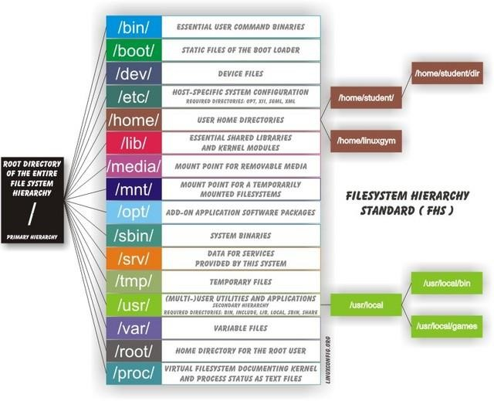
FILESYETEM HIERACHY
13

Slide 10
Moving around in the file system
Command | Action
pwd | "Print working directory" - show what dir you're in.
ls | List the contents of a dir.
ls -l | List the contents of a dir and show additional info of the files.
ls -a | List all files, including hidden files
cd | Change directory.
cd .. | Go to the parent directory.
Examining files
file | Determine the type of a file.
cat | Displays the contents of the file.
less and more | View text files and paginate them if needed.
head | Displays first 10 records of file
tail | Displays last 10 records of file
Manipulating files and directories
cp | Copy a file.
mv | Move or rename a file.
rm | Remove a file
mkdir | Make a directory.
12_{r}/_{m}30_{d}/0_{ir}9 | Remove an empty directory.

Slide 11
Moving around in the file system
Command | Action
File Compression
gzip | Compress the file
gunzip | Uncompress the file
tar | Archive mutiple files without compression
Disks and Filesystems
df | Show free disk space
du | Reports the sizes of directories
mount | Make a disk accessible
umount | Makes a disk inaaccessible
12/30/09

Slide 12
User Management
Command | Action
id | Print real and effective user id and group ids.
w | Display users logged in and what they are doing.
who | Display the users logged in.
whoami | Print effective user id.
useradd | Create a new user or update default new user information.
userdel | Delete a user account and related files.
usermod | Modify a user account.
groupadd | Create a new group.
groupdel | Delete a group
Groupmod | Modify a group
groups | Print the groups a user is in
passwd | Set a user's pass word.
su - username su - | Switching to user and root.
finger | See what users are running on a system.
chown | Change the owner of file(s ) to another user.
chgrp | Changes the group ownership of files.
12/3/09

Slide 13
Command | Action
Process Commands
ps | Lists all processes
uptime | View the system load
top | Monitor Processes
netstat | Netstat command displays various network related information such as network connections, routing tables, interface statistics etc.,
free | Display free memory
kill | Terminate Process
Scheduling Jobs
at | Schedule a job only once
crontab | Scheduling repeated jobs
Hosts
uname | Prints System Information
hostname | Prints System hostname
ifconfig | Set/display nework information
ping | Check if host is reachable
traceroute /09 | View network path to a host

Slide 14
Command | Action
Access Files:
/etc/hosts | Contains a list of known hosts (in the local network)..
File systems
/etc/mtab | This changes continuously as the file /proc/mount changes. In other words, when filesystems are mounted and unmounted, the change is immediately reflected in this file.
/etc/fstab | Lists the filesystems currently "mountable" by the computer. This is important because when the computer boots, it runs the command mount -a, which takes care of mounting every file system marked with a "1" in the next-to-last column of fstab.
System Administration
/etc/group | Contains the valid group names and the users included in the specified groups. A single user can be present in more than one group if he performs multiple tasks. For example, is a "user" is the administrator as well as a member of the project group "project 1", then his entry in the group file will look like: user: * : group-id : project1
etc/passwd | See "man passwd". Holds some user account info including passwords (when not "shadowed").
/etc/securetty | Contains the device names of tty lines (one per line, without leading /dev/) on which root is allowed to login.
/etc/shadow | Contains the encrypted password information for users' accounts and optionally the password aging information.
/etc/shells | Holds the list of possible "shells" available to the system.

Slide 15
References
http://www.linux.org/tutorial
https://access.redhat.com/knowledge/docs/Red_Hat_Enterprise
_Linux/
http://www.linux.com/learn

Slide 16
Q & A

